Slide 1
Geospatial Data Models, Formats and Depositories
Instructor: Dr. Eugene Levin, CP

Slide 2
Class plan (Learning Outcomes)
LO1: What is mapping and why mapping is needed?
LO2: What is different with spatial data compare to data you learned before?
LO3:What questions we can answer by means of GIS?
LO4:What is GIS Technology?
LO5: What Data Models are deployed by GIS?
LO6: Hands-on experience with installation and operations with open-source free QGIS

Slide 3
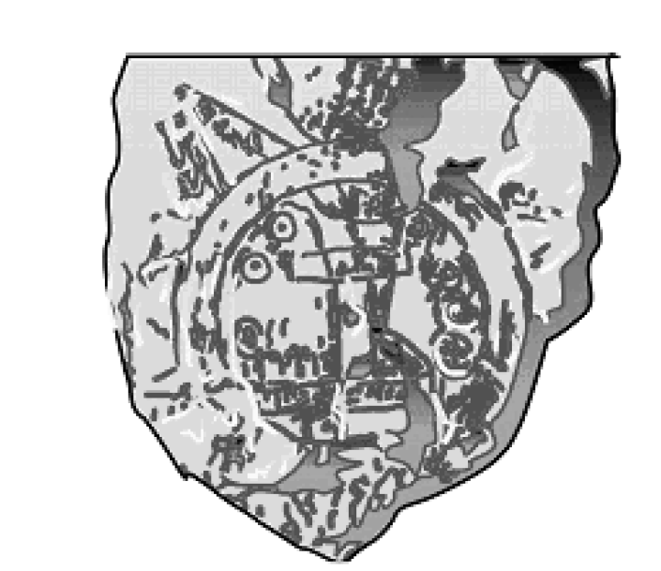
How new is mapping?/1000 B.C. map
Ancient Map of the Earth from Babylonia (1000 B.C.)

Slide 4
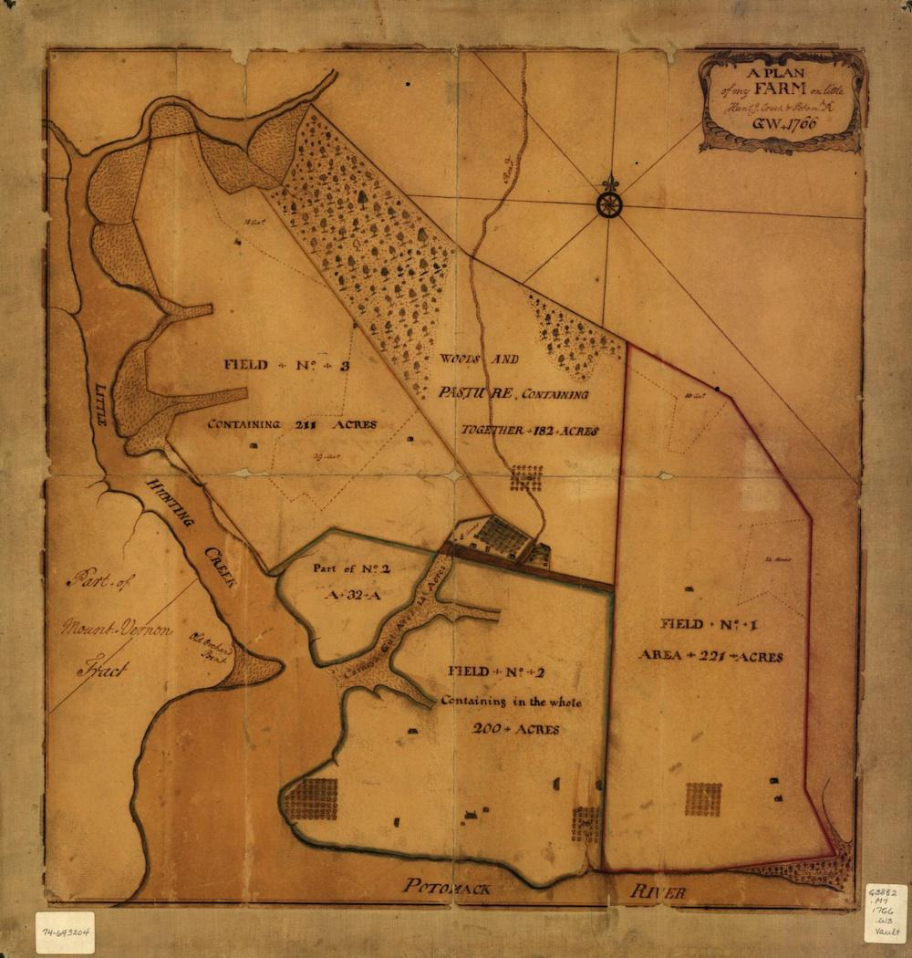
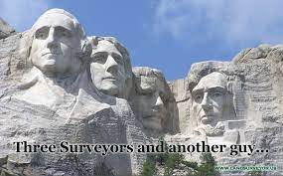
Washington’s Farm
In 1766, George Washington made this sketch of his farm…
Notes:
4

Slide 5
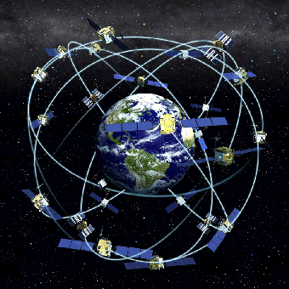
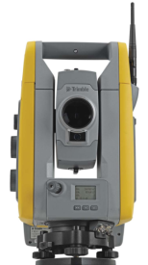
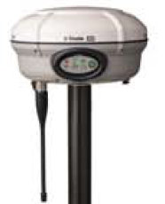
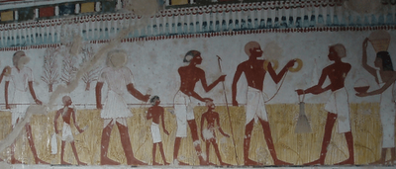

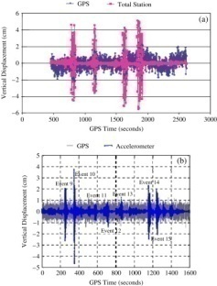
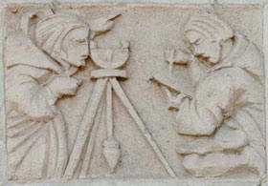

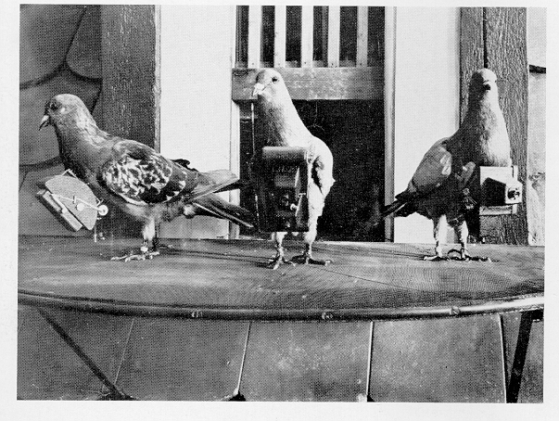
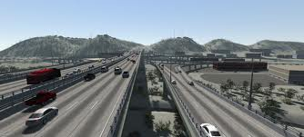

Data Collection for Mapping: Geospatial Engineering from 3600BC till now

Slide 6
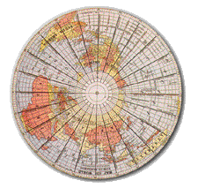
Cartography (was deployed before computers were invented)
Cartography is the art and science of expressing the known physical features of the earth graphically by maps and charts.
Notes:
6

Slide 7
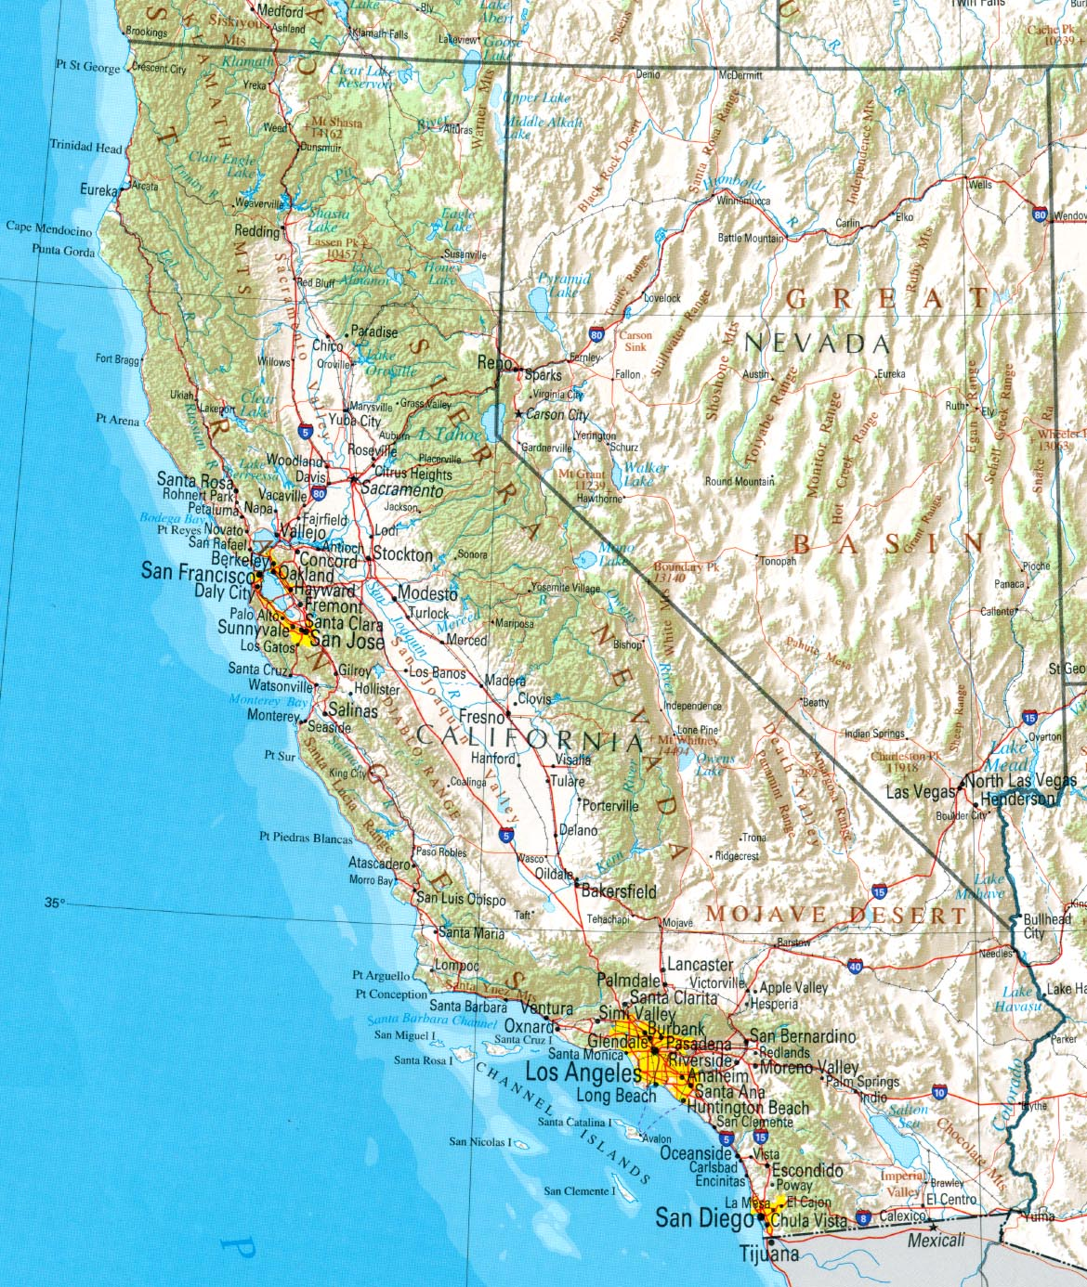
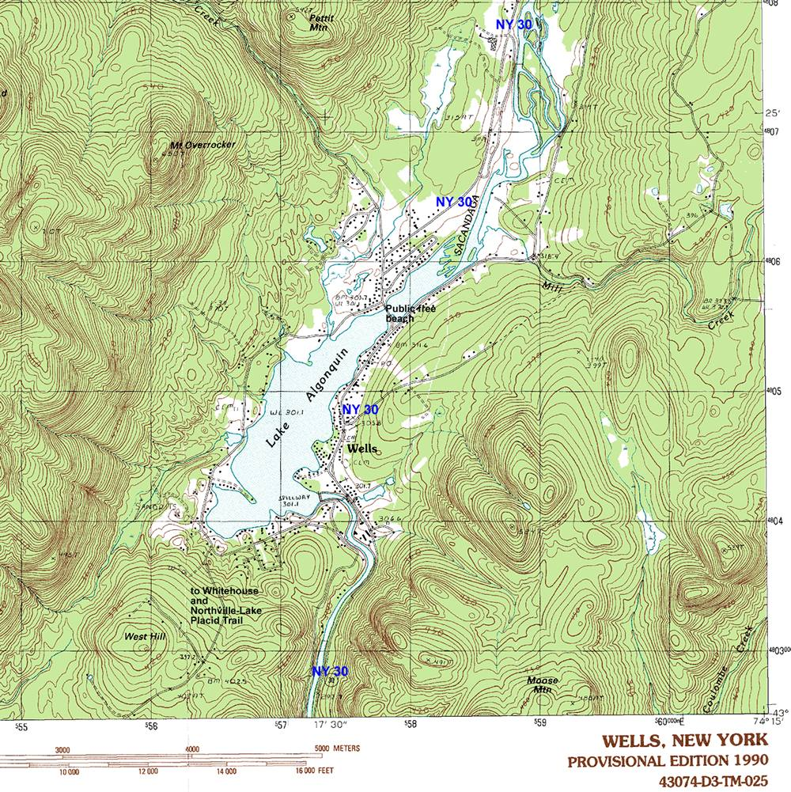
Reference & Topo Map

Slide 8
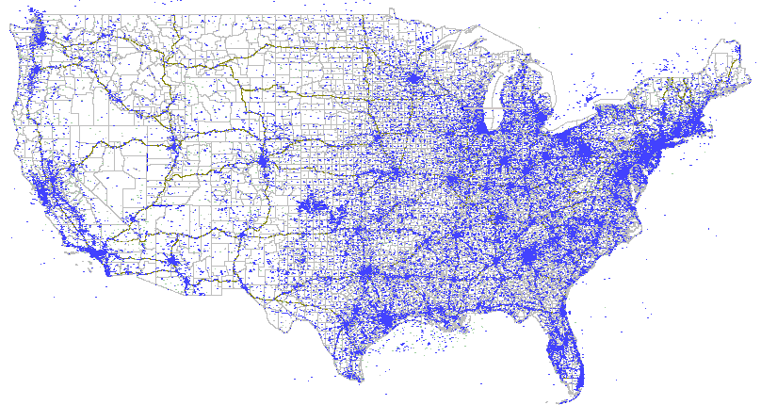
Simple Dot Map http://www.cybergeography.org/atlas/

Slide 9
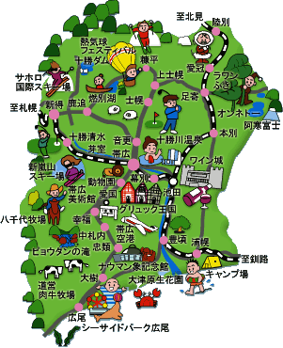
Picture Symbols/Icon Map http://tabi.joy.ne.jp/h-tokachigawa/icon/map.gif

Slide 10
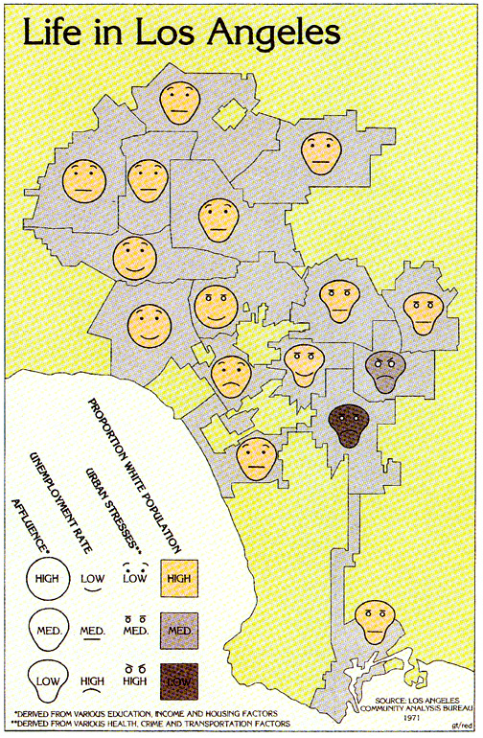
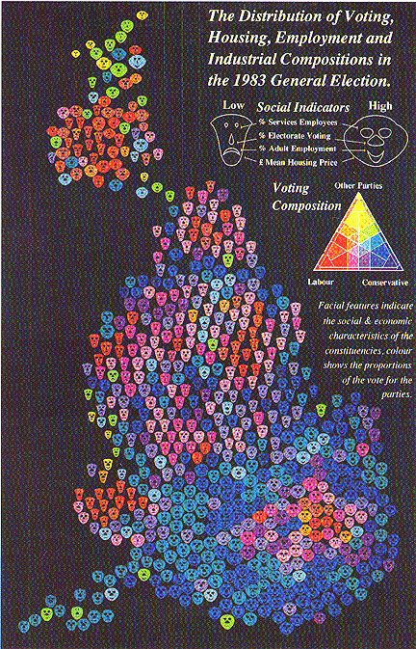
Multivariate Symbol: Chernoff Faces Source: Eugene Turner, Dan Dorling

Slide 11
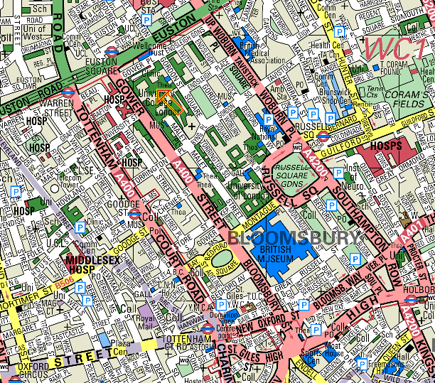

Slide 12
GIS – Definitions
Introduction to GIS
A system of computer software, hardware and data, and personnel to help manipulate, analyze and present information that is tied to a spatial location
Source: http://www.gis.com (ESRI)

Slide 13
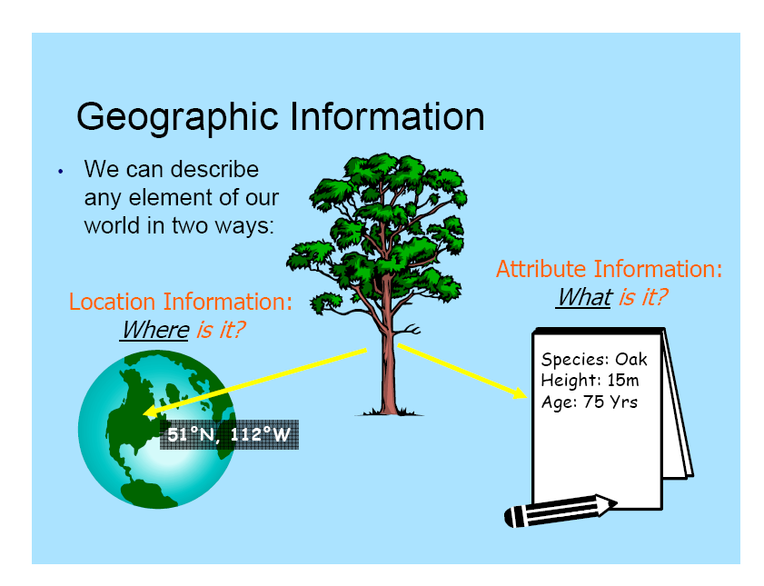

Slide 14
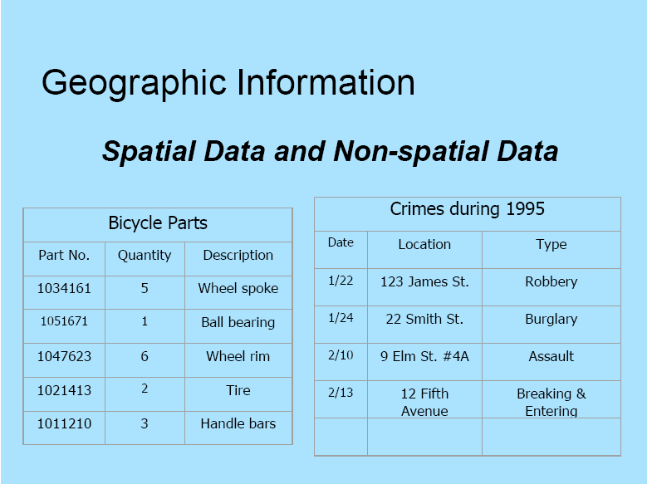

Slide 15
The Need for Spatial Information
Data
Information
Knowledge
Understanding

Slide 16
How spatial data are different?
3D/4D/5D world should be displayed in 2D –mapping projections;
Topology is important characteristics of spatial data.

Slide 17
Latitude-Longitude
Notes:
Latitude is the angle made at the center of the Earth between a place on the globe and a place directly south of it on the equator. It tells you how far north or south you are of the equator.
Longitude is the angle at the center of the Earth between a place on the globe and another place, at the same latitude, directly north of an agreed-upon spot on the equator. It tells you how far east or west you are of the agreed-upon spot.

Slide 18
Distortion.
Fitting sphere to plane causes stretching or shrinking of features

Slide 19
Map Projections
Projecting Earth’s surface always involves distortion:
shape
area
distance
direction
Notes:
A globe is the only representation of earth that can truly realistically represent all of these properties. A map projection by nature will distort one or a combination of these properties.

Slide 20
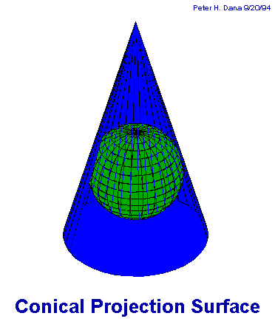
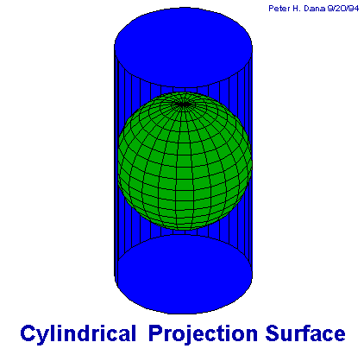
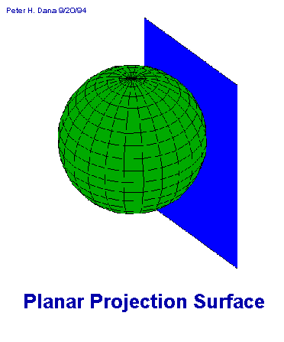
Map Projections

Slide 21
Map Projections
Mathematical conversion of the 3-D nature of the earth’s surface onto a flat 2-dimensional plane (screen or map)
(λ, ϕ) (x, y)

Slide 22
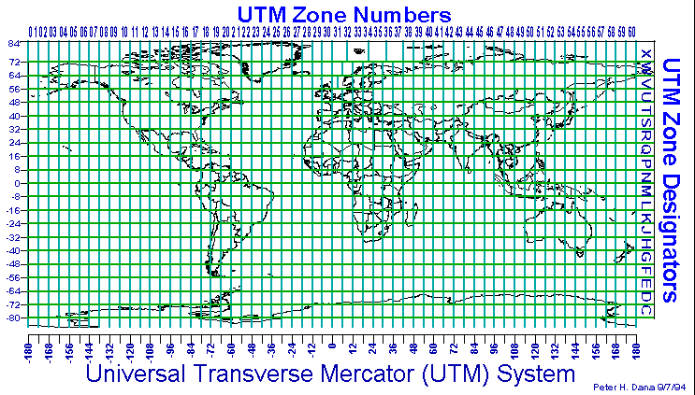
UTM

Slide 23

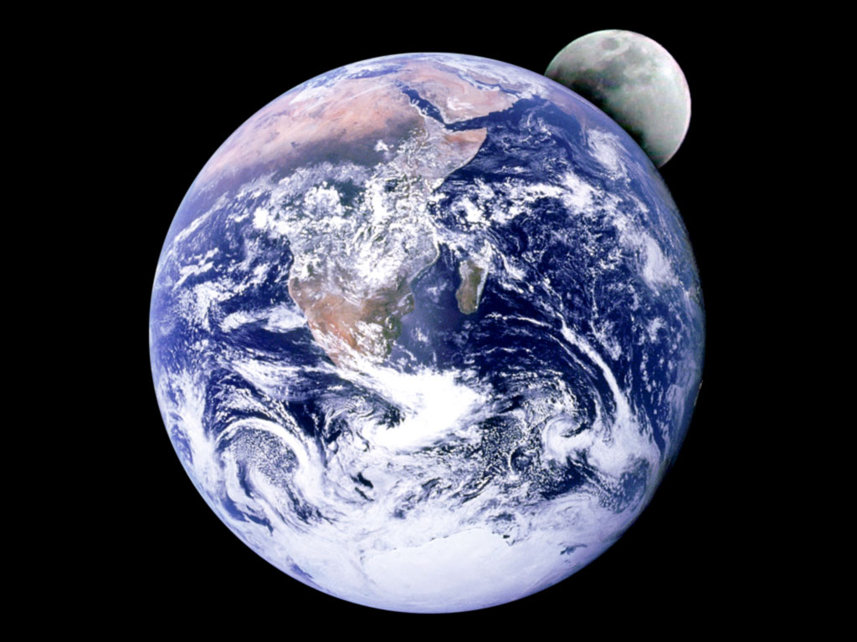
GIS is deploying datums

Slide 24

What is circumference of the earth value ?
Who measured it first?
How?

Slide 25
Datums
Reference frame for locating points on Earth’s surface
A set of parameters defining a coordinate system on earth’s surface
Defines origin & orientation of latitude/longitude lines
Defines the position of the spheroid relative to Earth’s center.
Notes:
A way to conceptualize a datum is that they form the basis for how measurements are organized on the earth’s surface. Datums use the spheroid values as their basis for what they “know” about how the earth is shaped. Datums define the position of a spheroid in terms of the earth’s center.

Slide 26
Common U S Datums
North American Datum 1927
North American Datum 1983
WGS-84 – used for your labs
GIS systens allows transformation between two coordinate systems that are based on different horizontal geodetic datums.
Notes:
26

Slide 27
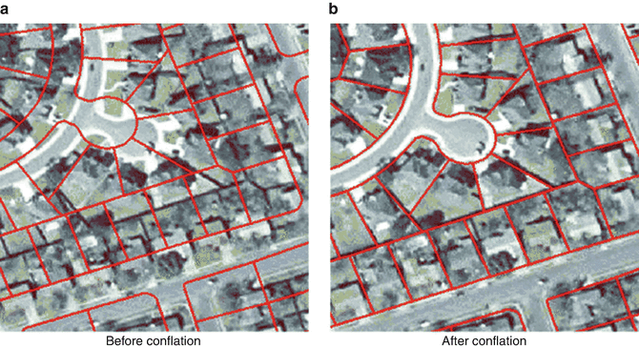
Why should we take care of projections consistency in GIS [Data conflation problem]

Slide 28
2. Topology
Topology --knowledge about relative spatial positioning
--managing data cognizant of shared geometry
Topography --the form of the land surface, in particular, its elevation

Slide 29
Vector Data Model Representing Data using the Vector Model: formal application
.
point (node): 0-dimension
single x,y coordinate pair
zero area
tree, oil well, label location
line (arc): 1-dimension
two (or more) connected x,y coordinates
road, stream
polygon : 2-dimensions
four or more ordered and connected x,y coordinates
first and last x,y pairs are the same
encloses an area
census tracts, county, lake
2
y=2
2
Point: 7,2
1
x=7
1
1
7
7
8
8
2
1
Line: 7,2 8,1
7
8
2
Polygon: 7,2 8,1 7,1 7,2
1
7
8

Slide 30
1
II
2
Birch
Node/Arc/ Polygon and Attribute Data
Relational Representation: DBMS required!(Geocodes)
I
Smith
Estate
A34
III
A35
4
IV
3
Cherry
Attribute Data
Spatial Data

Slide 31
Concept of
Vector and Raster
Real World
Raster Representation
Vector Representation
point
line
polygon

Slide 32
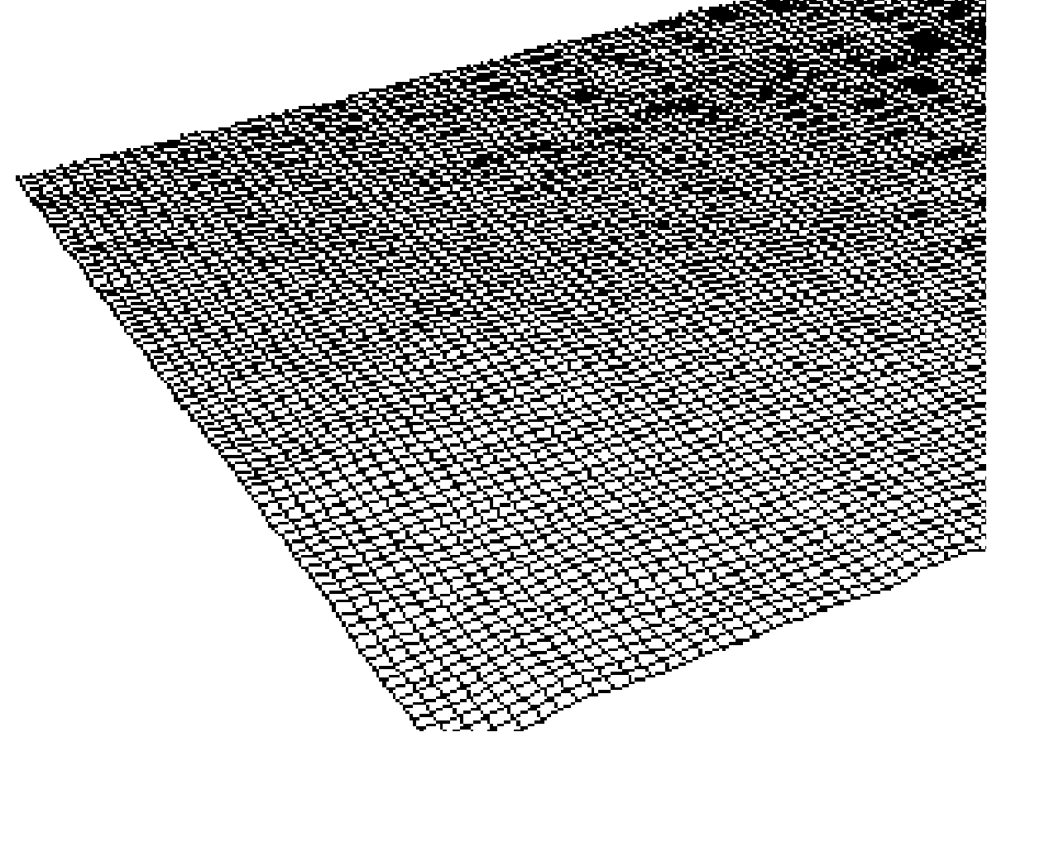
Digital Elevation Model
a sampled array of elevations (z) that are at regularly spaced intervals in the x and y directions.
two approaches for determining the surface z value of a location between sample points.
In a lattice, each mesh point represents a value on the surface only at the center of the grid cell. The z-value is approximated by interpolation between adjacent sample points; it does not imply an area of constant value.
A surface grid considers each sample as a square cell with a constant surface value.
Advantages
Simple conceptual model
Data cheap to obtain
Easy to relate to other raster data
Irregularly spaced set of points can be converted to regular spacing by interpolation
Disadvantages
Does not conform to variability of the terrain
Linear features not well represented

Slide 33
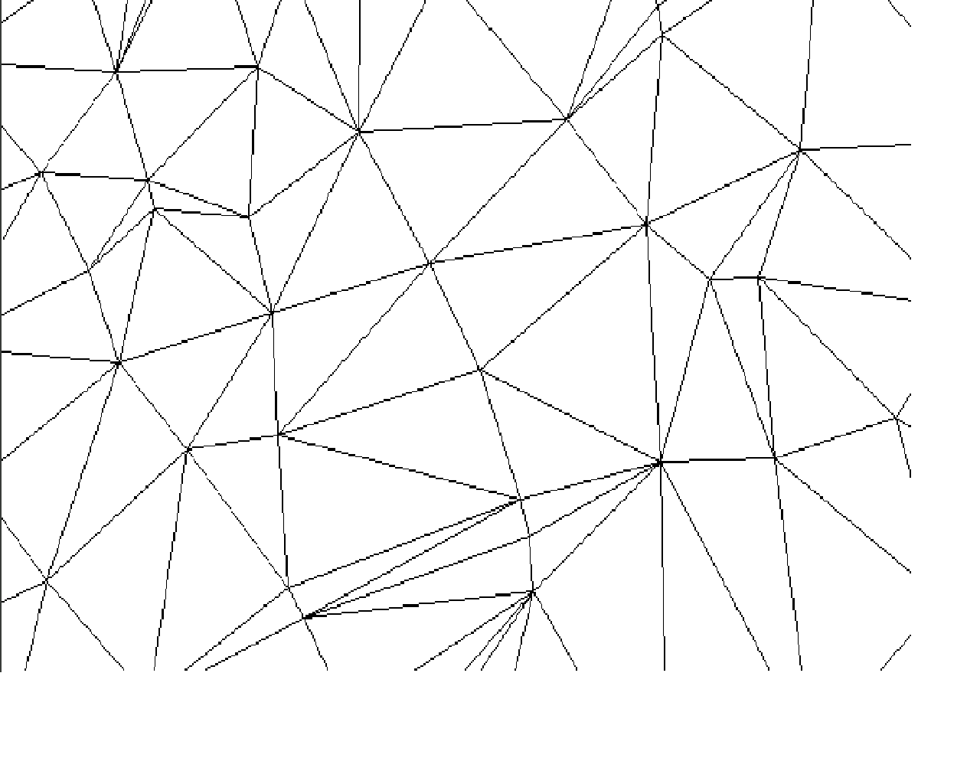
Triangulated Irregular Network
a set of adjacent, non-overlapping triangles computed from irregularly spaced points, with x, y horizontal coordinates and z vertical elevations.
Advantages
Can capture significant slope features (ridges, etc)
Efficient since require few triangles in flat areas
Easy for certain analyses: slope, aspect, volume
Disadvantages
Analysis involving comparison with other layers difficult

Slide 34
Geocoding
For example, a record in the tax assessment file should indicate to which school district it belongs to if the average property values of that school district were to be computed
These geographic labels or identifiers are called geocodes and the process of assigning geocodes is called geocoding
Each address in a city may have as many as 200 geocodes associated with it

Slide 35
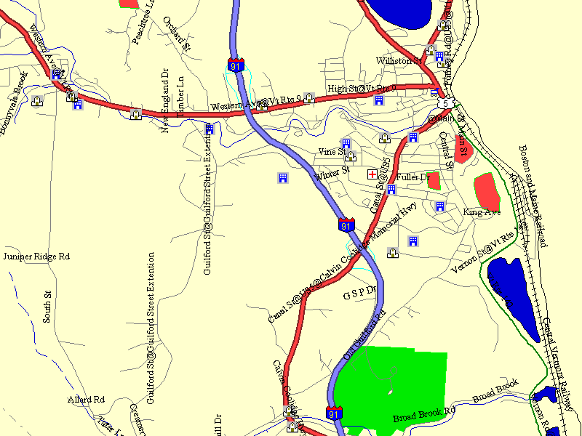
TIGER data model
TIGER (Topologically Integrated Geographic Encoding and Referencing) files
Developed by the U.S. Census Bureau for 1990 census, to remove inconsistencies between dime files and maps, experienced in 1980 census

Slide 36
Grid Index
Spatial Indexing

Slide 37
Minimum Bounding Rectangle
Spatial Indexing
Study Area

Slide 38
Spatial Querying in SQL with spatial extensions (Oracle…)
Data Querying
SELECT * FROM LandParcels
WHERE in_window(location, (x1, y1, x2, y2);
SELECT * FROM LandParcels A, LandParcels B
WHERE adjacent(a.location, b.location) and a.parcel_ID = 1234;

Slide 39
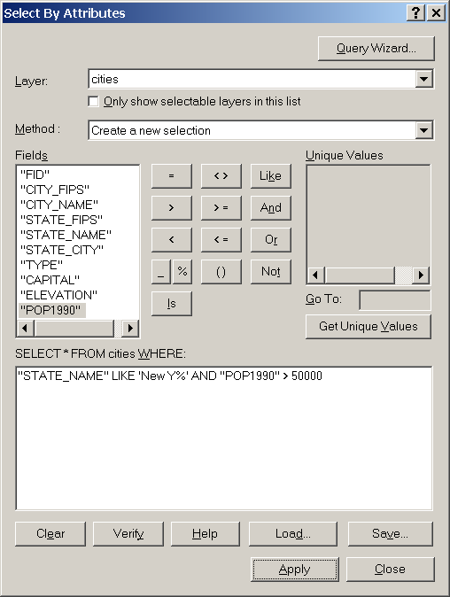
Query builder in ArcGIS
Supported keywords*
CURRENT_DATE
DATE – IN
ORDER – OR
NULL – NOT
LIKE – IS
DESC – ASC
AND – SELECT
FROM – WHERE
Good samples for spatial query in QGIS(tool you will use for your labs) can be found here: https://www.qgistutorials.com/en/docs/3/performing_spatial_queries.html

Slide 40
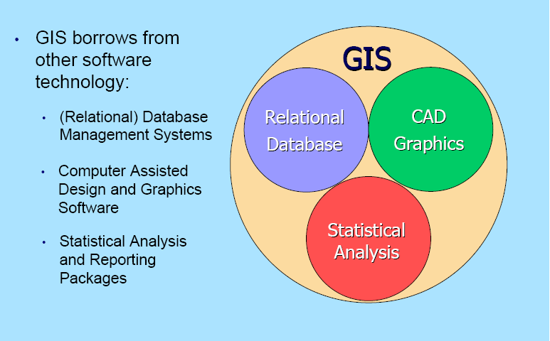
GIS Technology

Slide 41
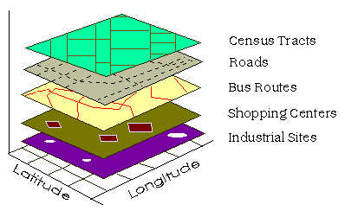
GIS Data
Introduction to GIS
Census Tracts
Roads
Bus Routes
Shopping Centers
Industrial Sites
From: The Geographer's Craft, Department of Geography, University of Colorado at Boulder

Slide 42
Summary
• A GIS uses data to describe our world
in two ways:
• With Location Data - Where is it?
• With Attribute Data - What is it?
GIS software maintains a link between layers of location and attribute data
• With this link, we can ask questions about our world… and get useful answers

Slide 43
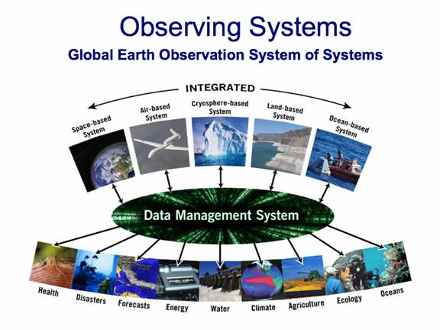
GIS data obtaining technologies
Earth Observation Systems
Terrestrial, Aerial, Satellite … Platforms

Slide 44
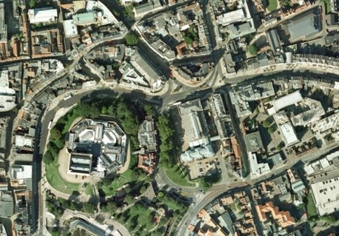






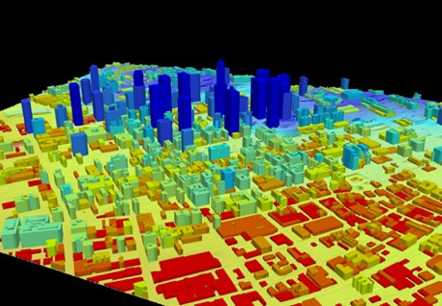
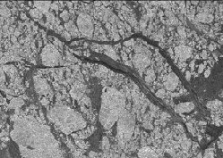



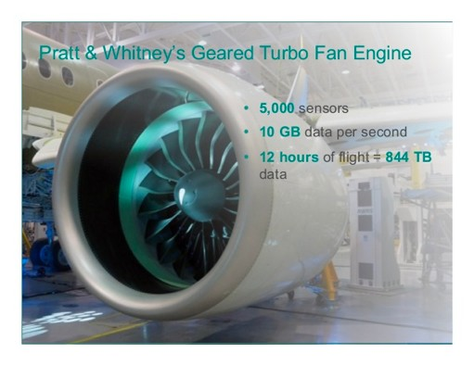


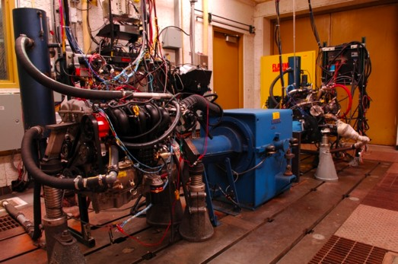


What is Big Data?
Examples
Internet data (images from the web)
Earth observation data (nasa.gov)
wikimedia.org
ibmbigdatahub.com
www.me.mtu.edu
www.slideshare.net
dataconomy.com
vision.cloudera.com
Manufacture sensor data
Copyright of logos belong to the companies.
Healthcare data
2

Slide 45
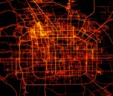




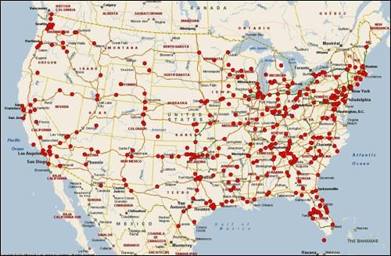
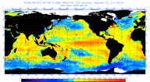
Geospatial Big Data (SBD)
Geo-referenced big data
Examples:
GPS trajectories
Check-in records
Earth observation imagery
Microsoft.com
Beijing Taxi GPS trajectories
Image from the web
Mobile app data
geospatial events, e.g., crimes, accidents
Climate model simulations
Why “geospatial” matters?
Impact everyday life
Computational challenges
Fbi.gov
geospatial events: highway serial killing
Nasa.gov
Earth imagery
Nooa.gov
Climate model simulation

Slide 46


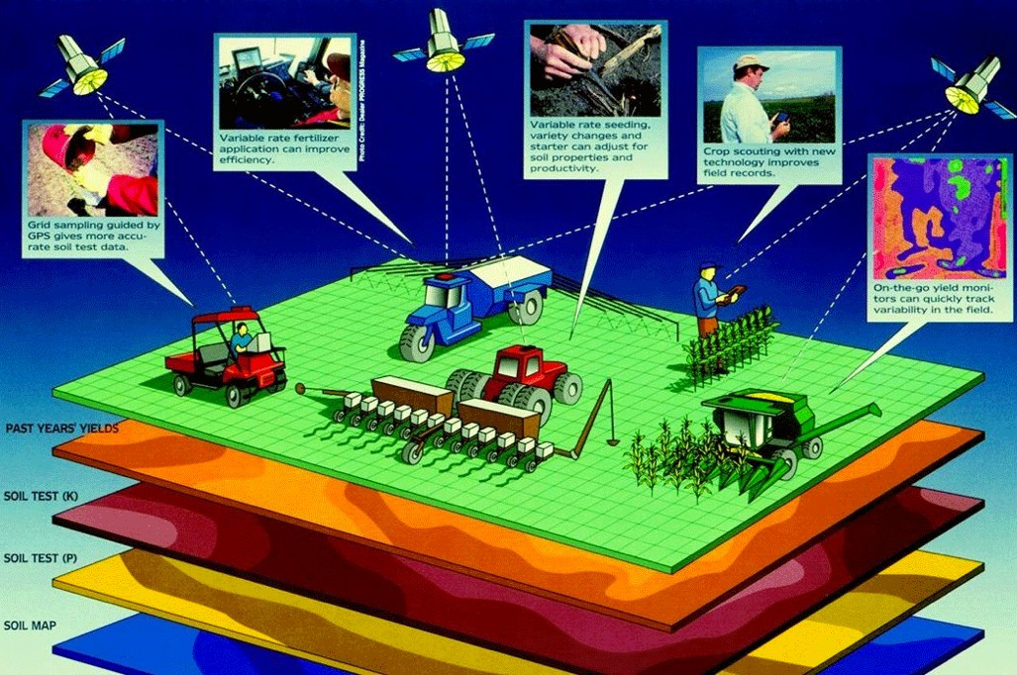
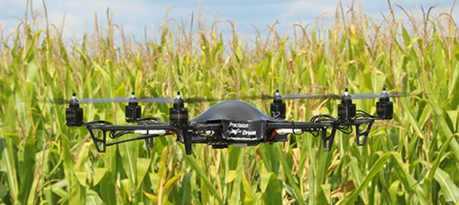
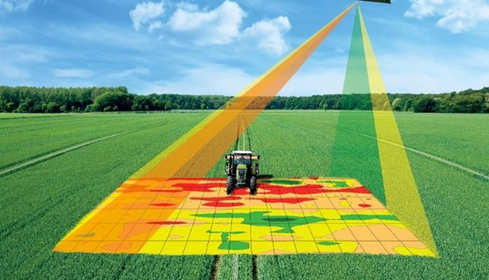

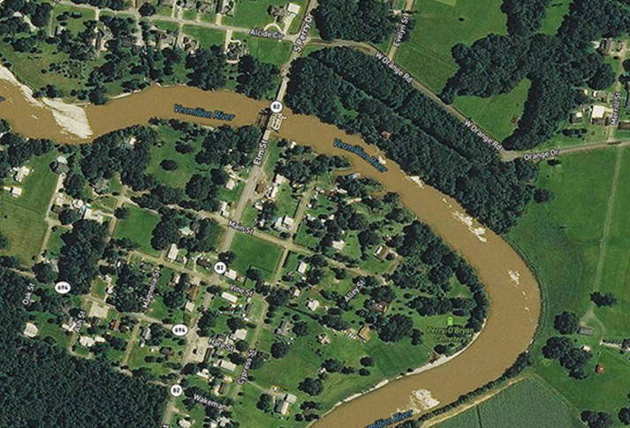
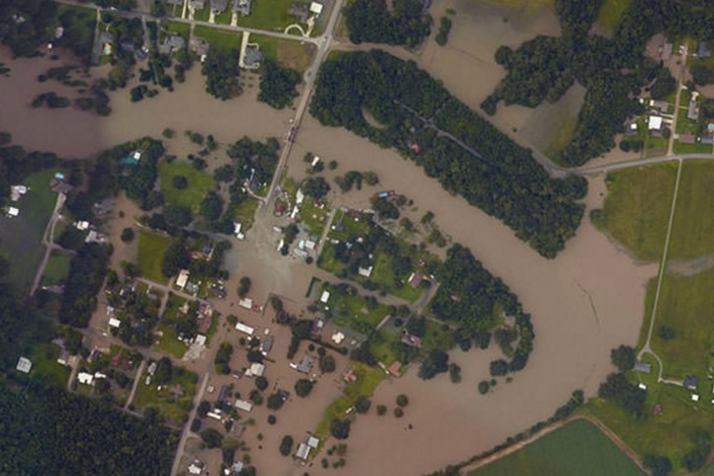
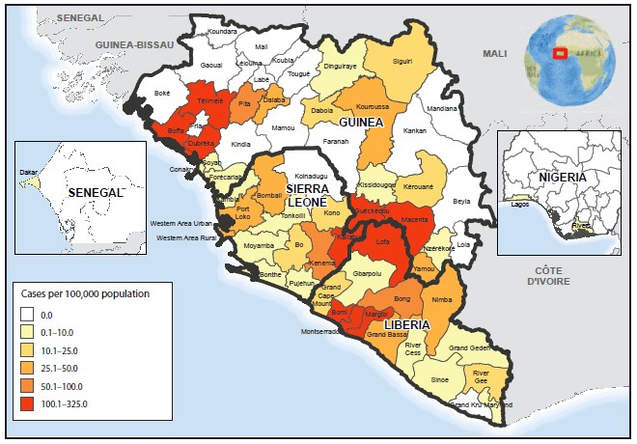


Geospatial Big Data Analytics Applications
sustainableamerica.org
Location based services
gps4us.com
Precision agriculture
innovationtoronto.com
arcgis.com
Disaster response (before and after flood)
cdc.gov
Image from the web
Disease outbreak detection
6

Slide 47
GIS implementations
Standalone (ArcGIS, Bentley MicroStation)
Web-Based( multi-tier architectures)
Commercial (ESRI, Bentley,MapInfo);
Free open sourced- QGIS
Formats are interoperable (compatible)

Slide 48
Next things to do
Work on Lab-assignment
Watch videos on BB
Good Luck!

